Slide 1
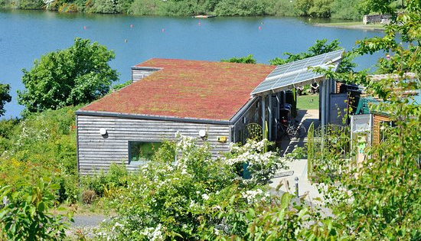
The Ecology Centre

Slide 2
What do we do at The Ecology Centre?
Hands-On Environmental Experience
The Ecology Centre provides a friendly, relaxed way to engage with and learn about the environment.
Accessible & Inspiring Methods
The Ecology Centre fosters enthusiasm and curiosity through accessible learning.
Community & Personal Growth
The Ecology Centre boosts confidence and self-esteem; we engage local communities, especially youth, seniors and those with limited opportunities.
Sustainable Resource Management
The Ecology Centre uses ecological principles on-site and in outreach
Valued Volunteers
The Ecology Centre recognises volunteers as essential contributors.
Inclusive & Welcoming
The Ecology Centre is open to all, regardless of age, ability, gender or background.

Slide 3
Our site
The Ecology Centre started its life at Craigencault Farm in 1999, becoming a formalised organisation in 2000. For 15 years it operated from Craigencalt Farm until the lease came to an end.
In July 2014, The Ecology Centre purchased 5 acres of land on the eastern shore of Kinghorn Loch in Fife. Plans and funding were in place for a new building thanks to the support of the Big Lottery, The Robertson Trust, Fife Council and others. Building work was completed in September 2015.
The new building, designed by Architect Stuart Hannah of ADD Design, is built to Passivhaus standards offering exceptional levels of energy efficiency. Wherever possible, we have used natural, recycled or recyclable materials. A key feature is the use of old shipping containers, refurbished and insulated to provide workshop and storage space.
The building provides a base for our volunteers, visitors and staff as well as for our room hire. Since we moved to the site we've worked hard to transform the grounds. We inherited a barren area of grass and car parks and since 2015 we've developed paths, play areas, growing spaces, woodland, wild flower meadows, ponds, habitats for amphibians and more besides with the aim of enhancing biodiversity and providing opportunities for environmental education, volunteering and enjoying the outdoors.

Slide 4
Who forms the Management team of The Ecology Centre?
Donna McArdle
General Manager
Lyle Boyle
Seagrass Officer
Chris Pearson
Café Manager
Ewan Malecki
Site Manager
Liz Corke
Education Manager
Auxi Barrera
Volunteer Manager

Slide 5
Restoration Forth
The Ecology Centre is a key delivery partner in Restoration Forth.
Restoration Forth is a 3-year restoration project that aims to restore both seagrass and the European flat oyster across the Firth of Forth.
Through community participation, 30,000 oysters and up to 4 hectares of seagrass meadows will be restored by 2025.
Community volunteers have helped monitor and map the existing seagrass meadow on Burntisland Sands along with contributing to the restoration of three seagrass meadows across the Forth.
Volunteers have sown seagrass seeds through the restoration technique known as Dispense Injection Seeding (DIS), which uses sealant guns to inject seeds into the seabed at low tide.
In addition to seed-based restoration methods, the translocation and transplanting of cores of living plants has also been investigated and trialed in one location.
Cores containing seagrass are removed from healthy donor meadows and planted in uncolonised areas.

Slide 6
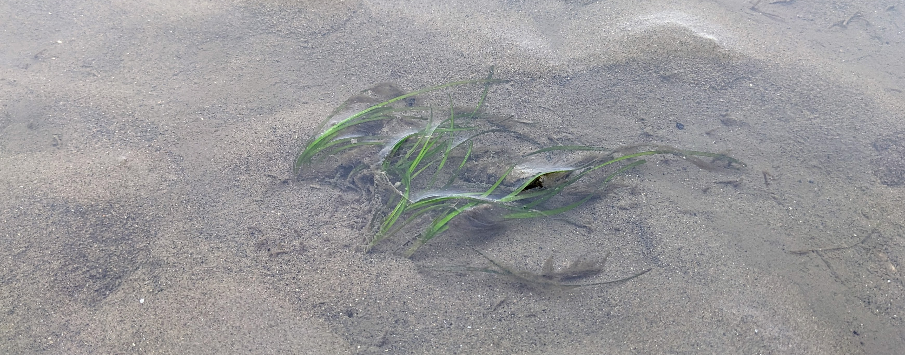
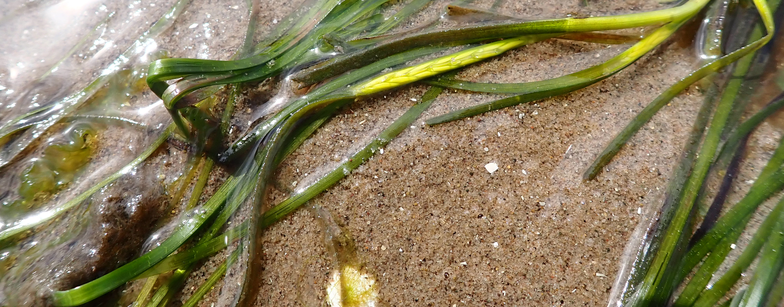
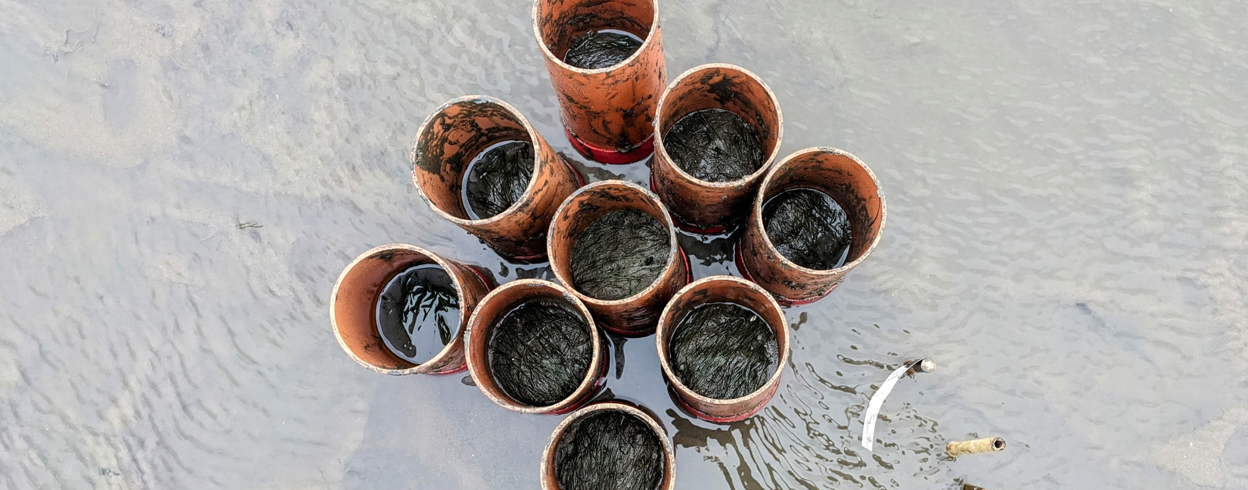

Slide 7
The Nest Cafe
Local dog friendly Café set upon Loch Kinghorn and surround by beautiful scenery/walking routes
Caters our volunteer lunches and warm spaces initiative
Used to provide catering for all hosted events, for external and internal The Ecology Centre events.
Food served using produce from our community garden, local businesses and FairShare
Employes local young people and, also offers volunteering opportunities to give work experience to help lead to future employment
As a registered REHIS hygiene training centre, provides elementary hygiene training to volunteers and external organisations.

Slide 8
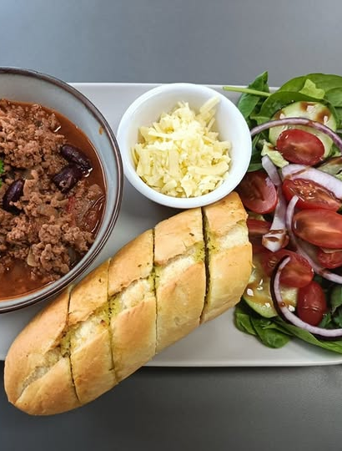
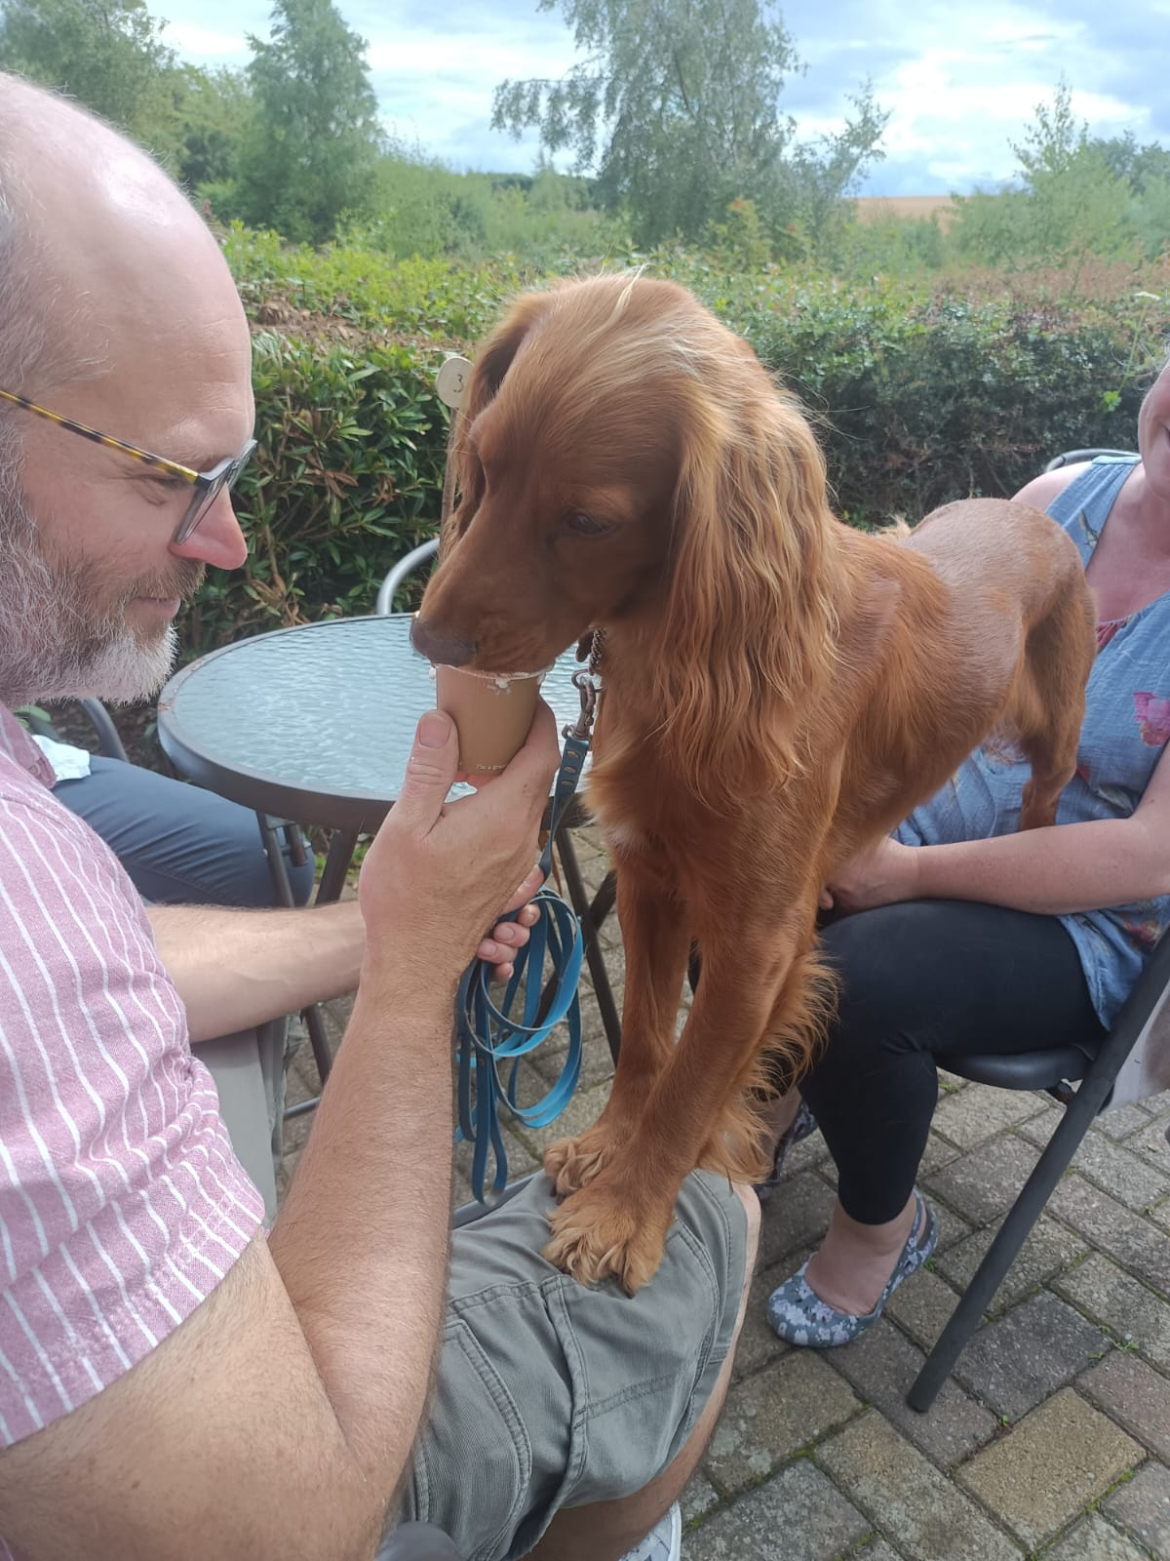
The Nest Cafe

Slide 9
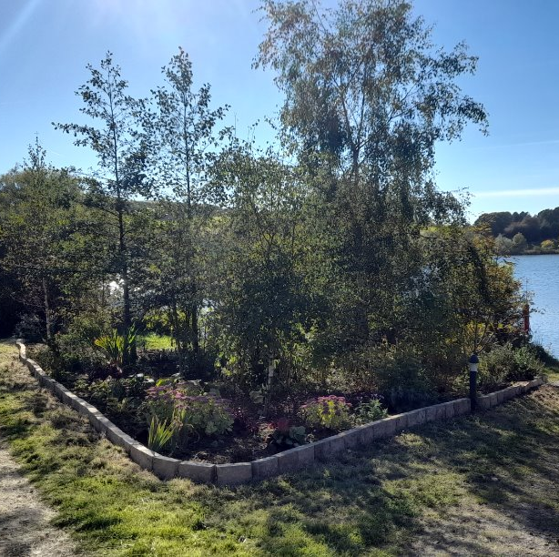
Site Management

Slide 10
Site Management is a pivotal aspect in the running of The Ecology Centre
The site is extensive with a wide variety of habitats and flora which need constant upkeep and maintenance
Between the Site Manager, Site Supervisor and the volunteer team we allocate tasks based on priority and importance
Site Management also deals with the facilities side of TEC – which include – septic tank, solar panels, heating, fire safety, sluice and reservoir maintenance and any other infrastructure on site.

Slide 11
The Site Manager is also responsible for the community garden and poly tunnel in which TEC grows fruit and vegetables for the café
TEC have also a long-standing agreement with Kinghorn Community Land Association (KCLA) for an “in-kind” agreement of 600 hours per annum
The Site Management also has the Tool Shed under its remit
Between all these components the site team are never short of work!

Slide 12
Common tasks on site include mowing & strimming, weeding and bed preparation, sowing seeds & harvesting
We also implement larger scale projects when they arise which often include groundworks, slab-laying, wood working and painting
We also have legal responsibility for the reservoir so the sluice and grills for the reservoir and culvert are regularly inspected and cleared as needed

Slide 13
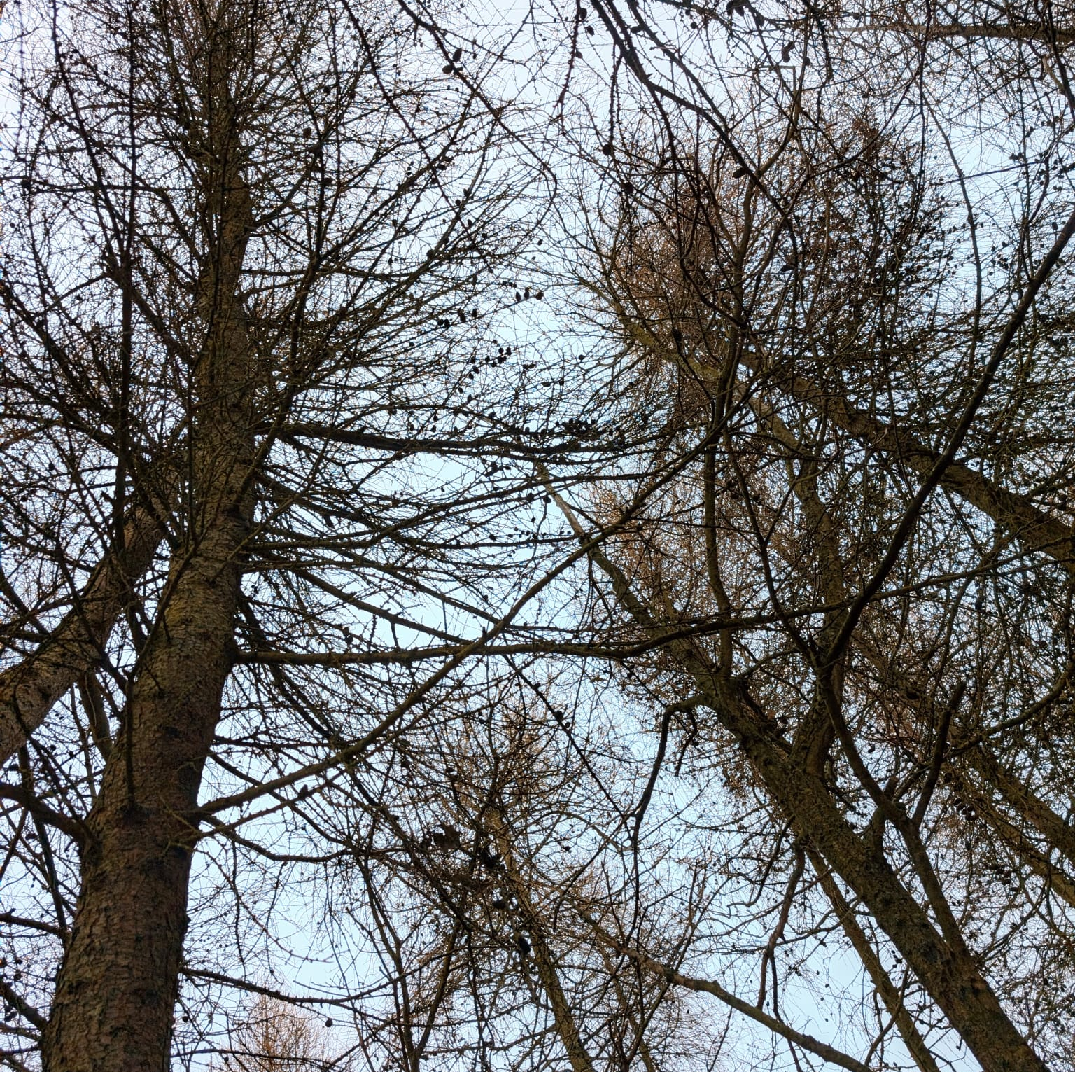
Outdoor learning

Slide 14
Our Expertise:
The Education Team is dedicated to delivering bespoke outdoor learning programs. With over 20 years of experience, our qualified practitioners specialise in nature-based education for children, staff, and communities.
Our Approach:
We offer inclusive, child-centered, and fun learning experiences designed to foster a deep connection with nature while supporting personal growth, creativity, and resilience.
What We Offer:
Bespoke Environmental Education sessions
Forest Schools (SCQF FOLA levels 2 & 4)
Nature Connection & Sustainability
John Muir Awards
Bushcraft & Practical Skills
Small Group Nature Nurture Sessions
Staff CPD & Training

Slide 15
What is FOLA?
FOLA (Forest & Outdoor Learning Awards) is only one of the programs we offer. It is a structured, Scottish Credit and Qualifications Framework (SCQF) qualification for outdoor learning achievements. At The Ecology Centre, we offer FOLA levels 2 & 4.
Levels Overview
Level 2: Introduction to Forest School and developing foundational skills
Level 4: More in depth outdoor and forest skills, focusing on skills and deeper environmental engagement

Slide 16
The 6 Principles of Forest School
1. Long-Term Process
Regular, repeated sessions that build on each other.
2. Natural Environment
Learning takes place in woodlands or natural spaces
3. Learner-Centered
Activities shaped by children’s interests and needs.
4. Holistic Development
Focus on building confidence, resilience, and creativity.
5. Supported Risk-Taking
Safe exploration and risk-taking in the natural environment.
6. Qualified Practitioners
Led by trained Forest School professionals who continuously develop their skills.

Slide 17
Volunteering at The Ecology Centre

Slide 18
Volunteering Opportunities at The Ecology Centre
At The Ecology Centre we currently offer the following volunteering opportunities:
Gardening and Site Maintenance Assistant
ToolShed assistant
Café assistant
Kitchen assistant
Education assistant
Woodwork

Slide 19
We offer our volunteers a place to enjoy themselves and have fun
We are flexible with our volunteers, we don't impose a number of volunteering hours a week.
On Tuesdays and Wednesdays, we offer lunch to our volunteers in exchange for a donation when possible.
Volunteers on a Thursday can enjoy staff discount at The Nest Café
All our volunteers will have a key dedicated person that will work with them

Slide 20
Benefits of volunteering at The Ecology Centre
Team work
Meeting new people
Connecting with nature
Mental health improvement
Develop new skills and boost confidence
Physical activity
Sense of purpose

Slide 21
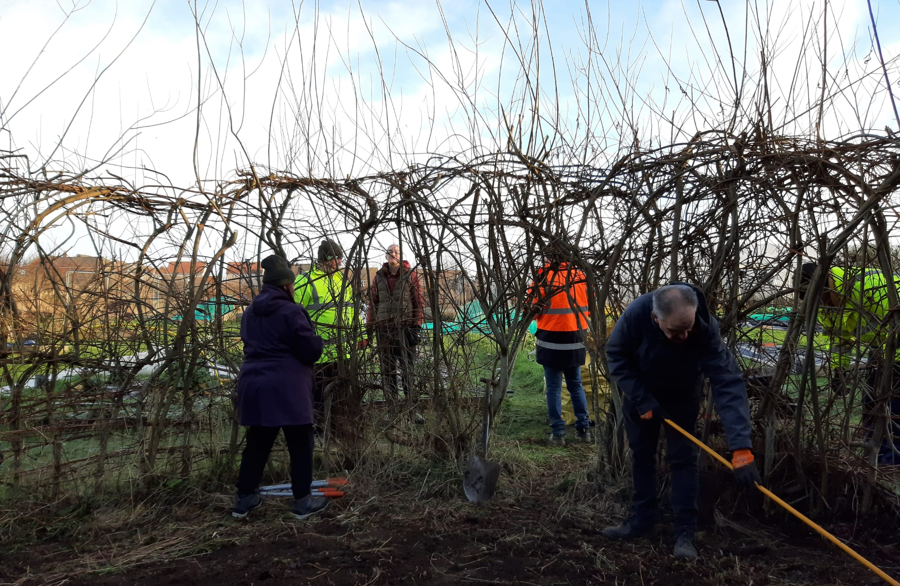
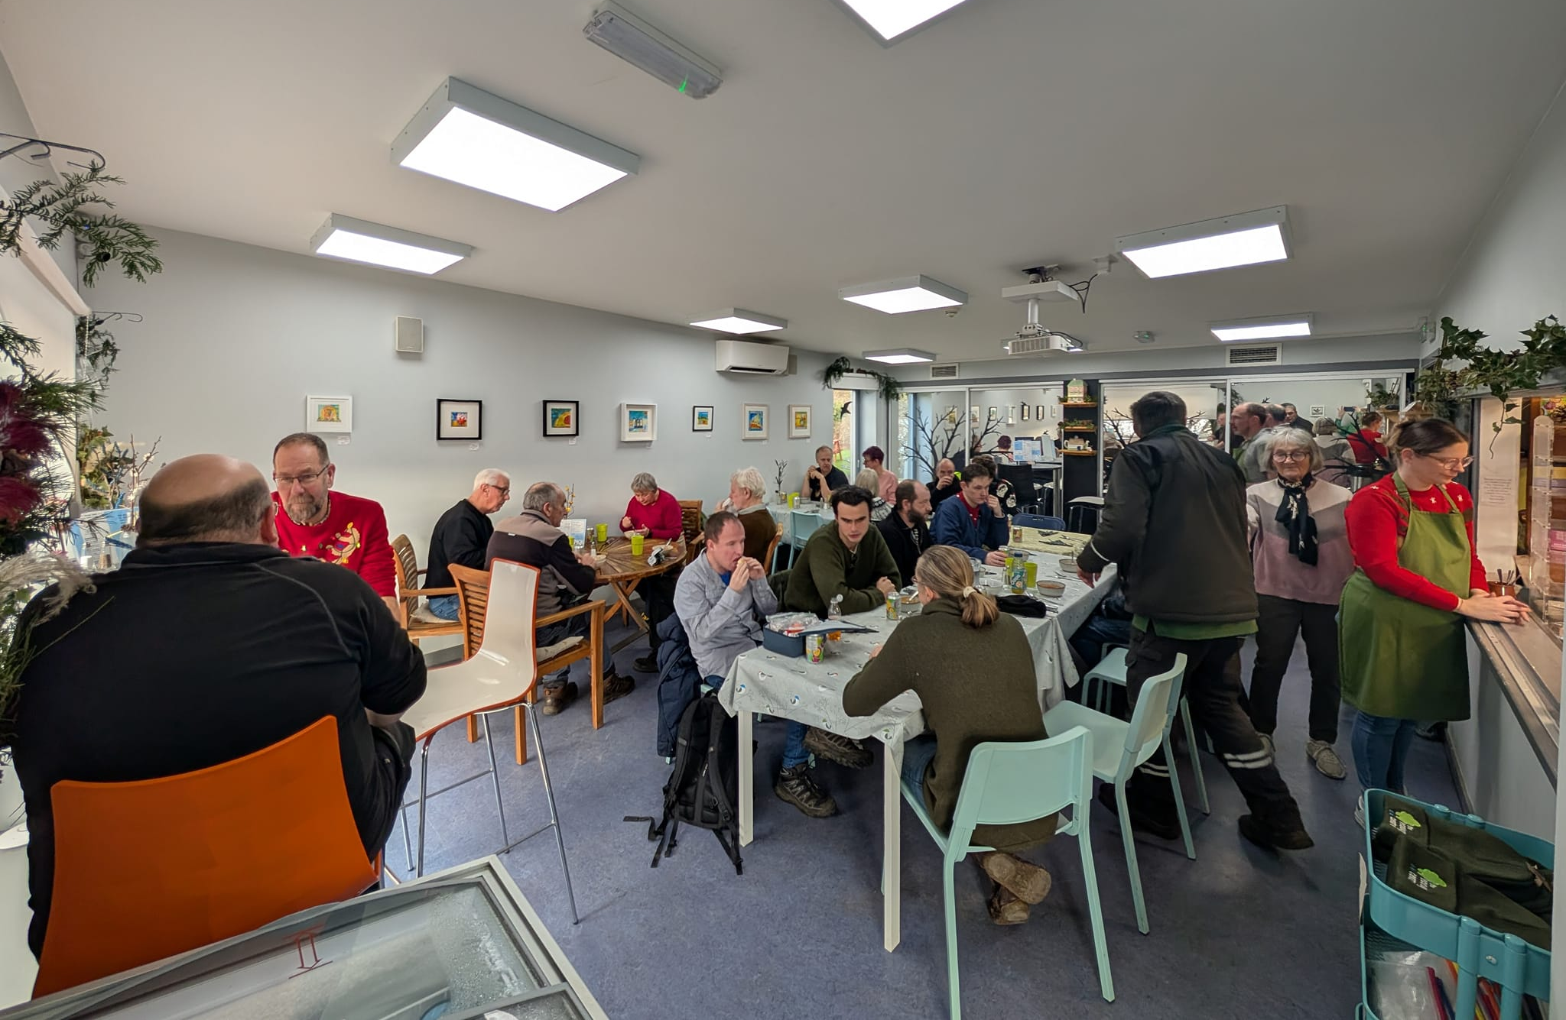
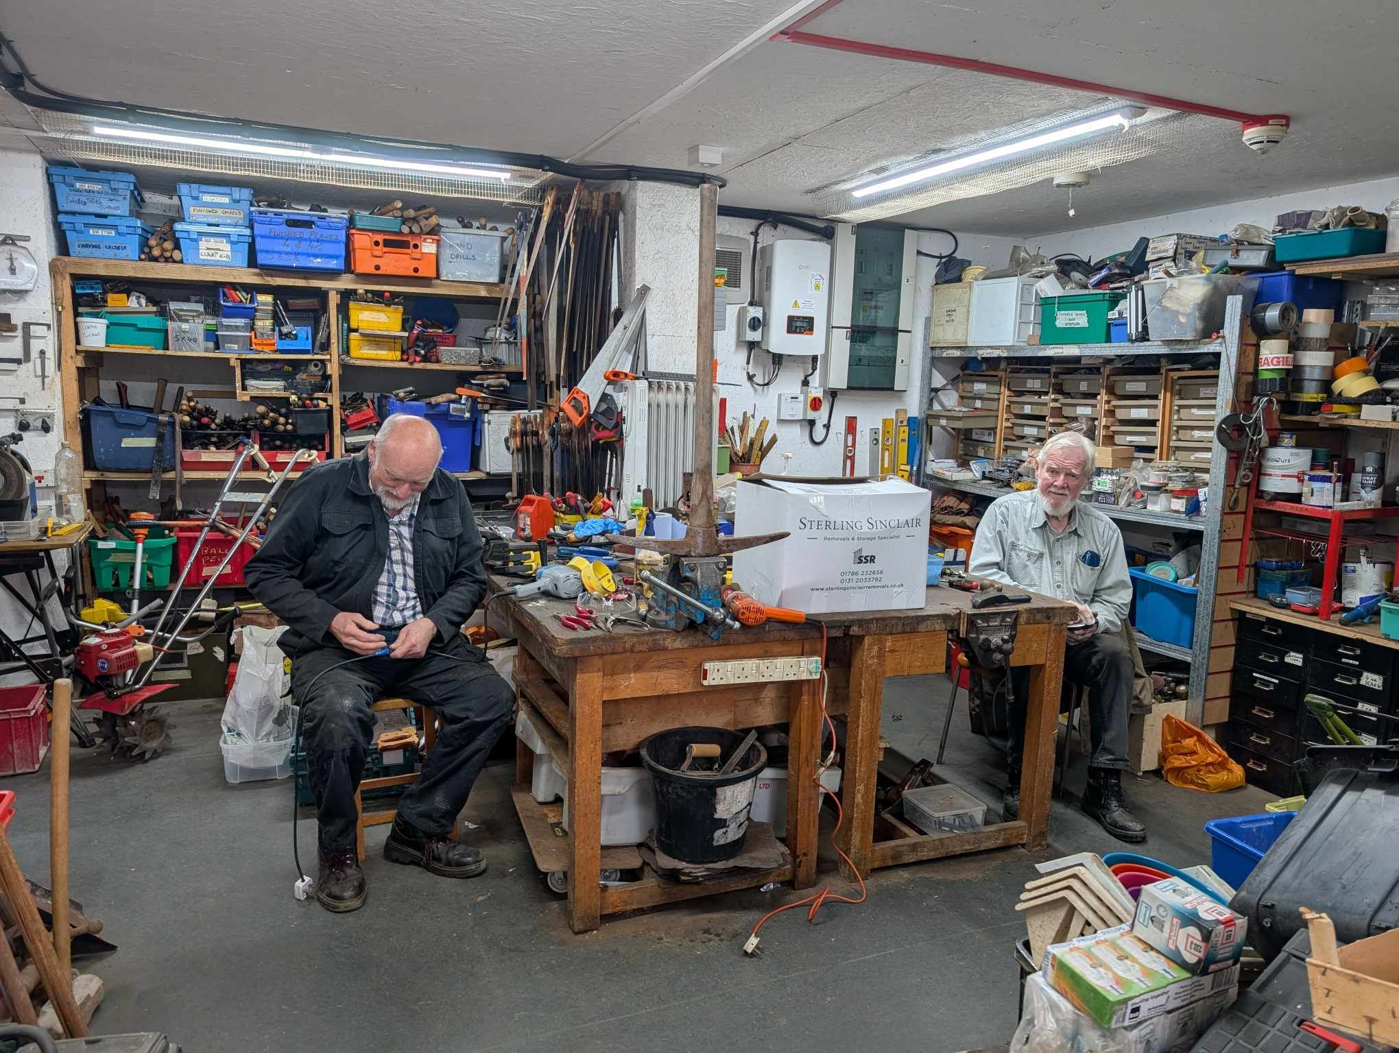
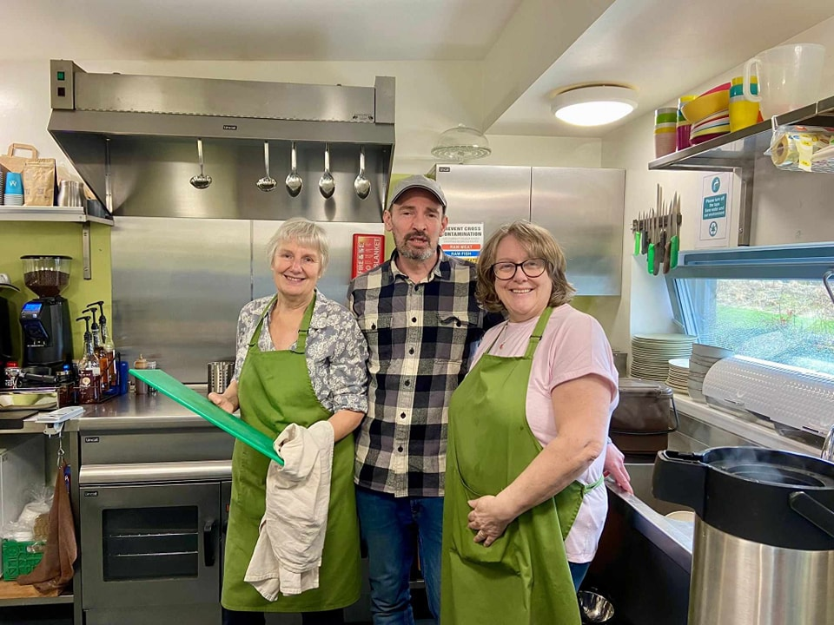
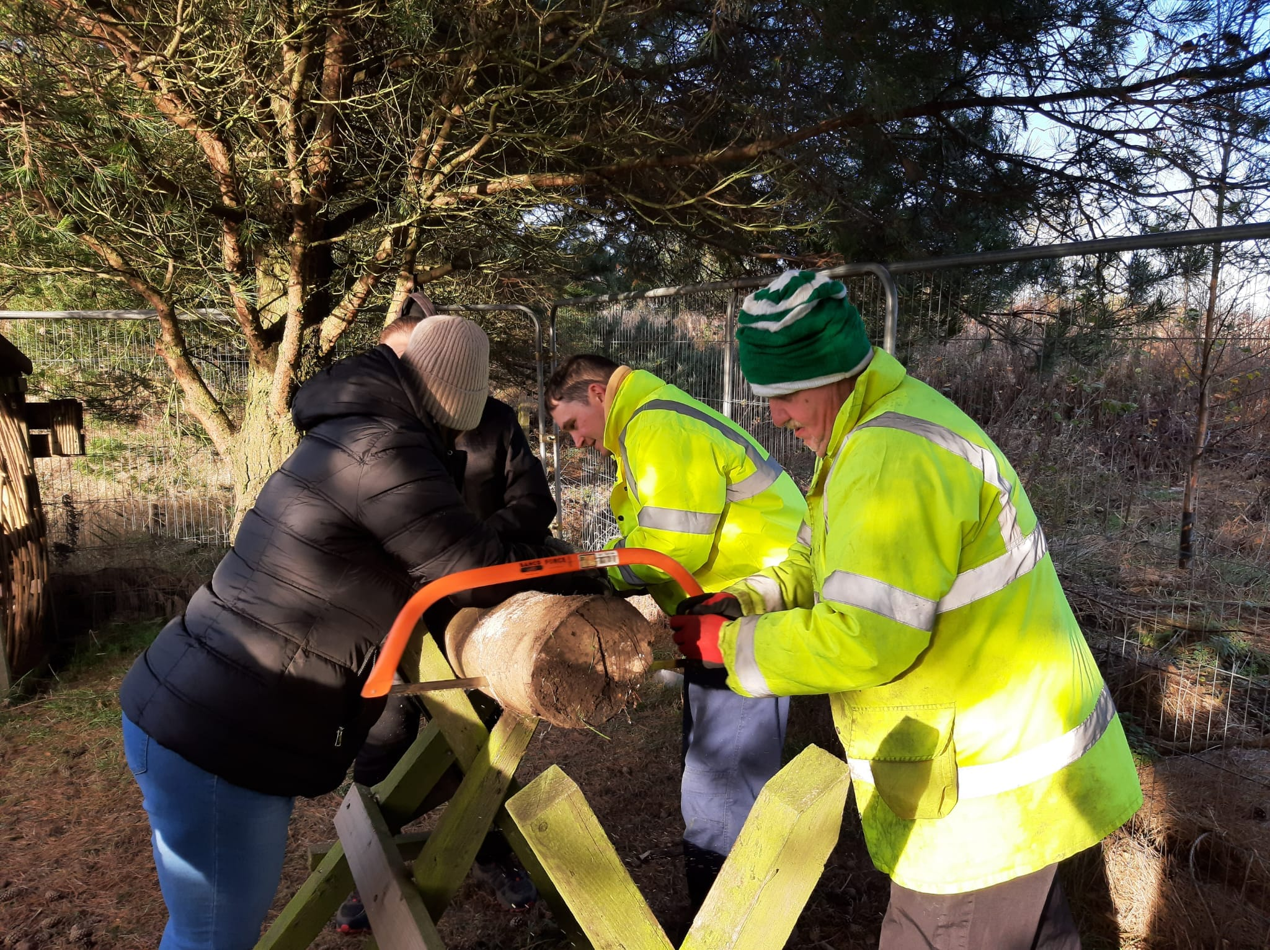

Slide 22
Any questions?

